Slide 1
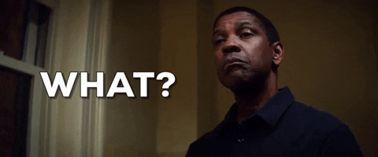
The Pastiche in our Stars: An Exploration
Azka Younas

Slide 2
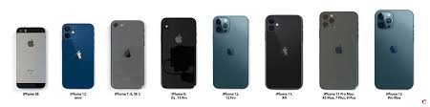
Context for the Study
Newness
Intertextuality and Pastiche
Agent or performer

Slide 3
Statement of Purpose
The study intends to analyze how pastiche works with re concerning Denzel Washington create meaning in the selected works.
Notes:
32-24

Slide 4
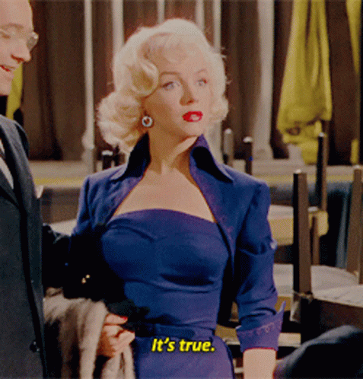
Star Theory (Richard Dyer)
Stars can be understood in three dimensions:
Image
Commodity
Ideology
Notes:
Stars are important and can be read for the meanings they carry but the meaning they carry while they perform Richard dyer we took the basis of the idea and stars can be studied/to support the rational and understand stars quote of star to be studied

Slide 5
Theoretical Framework
Pastiche Fredric Jameson
Conceptual framework

Slide 6
Death of the subject
The situation where novelty and innovation are no longer possible
Mimic the existing styles and reuse the existing works.
Pastiche is not devoid of creativity or artistic merit
Pastiche is an homage, a nod of respect towards the existing works
Free from the bite of irony
Pastiche imbibes the new work with meanings from old works in all scenarios

Slide 7
Literature Review
Pastiche in Film
Research on Denzel
Sarah Christine Smith, Douglas Pye, Andrew Higson, James Keller, Winczewski, Jennifer Harrod, Kamilla Elliott, Christopher Bell, Baums Gray, Ed Guerrero, Donald Bogle, Todd Boyd, Adilifu Nama, James A. Snead.

Slide 8
Research Gap
The literature review reveals that pastiche has been explored to identify its common features and how directors use repetition to unify their work. Denzel Washington has been studied for his distinctive performance style, but there is a noticeable gap in linking pastiche to film actors.

Slide 9
Research Method

Slide 10
Research Objectives
The objectives of the study are as follows:
To analyze the cinematic techniques to create pastiche through Denzel Washington in the selected works
To explore the key meanings that result from pastiche in the selected works
To discuss pastiche viz a viz artistic creation

Slide 11
Research Questions
The study aims to address the following questions:
In what ways does pastiche work through Denzel Washington in the selected works?
What are the key meanings that pastiche creates in the selected works?
How does pastiche link with the possibility of creativity in postmodernism in the selected works?

Slide 12
Textual Analysis
Alan Mckee
Catherine Belsey

Slide 13
No. | Title | Director | Distributor | Runtime
1. | American Gangster (2007) | Ridley Scott | Universal Pictures | 157 Minutes
2. | The Taking of Pelham 123(2009) | Tony Scott | Sony | 106 Minutes
3. | Unstoppable (2010) | Tony Scott | 20th Century Studios | 98 Minutes
4. | Equalizer Trilogy | Antoine Fuqua | Sony | 132 Minutes
5. | The Little Things (2021) | John Lee Hankook | Warner Bros. Pictures | 128 Minutes
Notes:
Delimitation italicize only the name not year

Slide 14
Role, performance, appearance, camera work, and mise-en-scène. These aspects are informed by theoretical insights from Bordwell, Thompson, and Chatman.

Slide 15
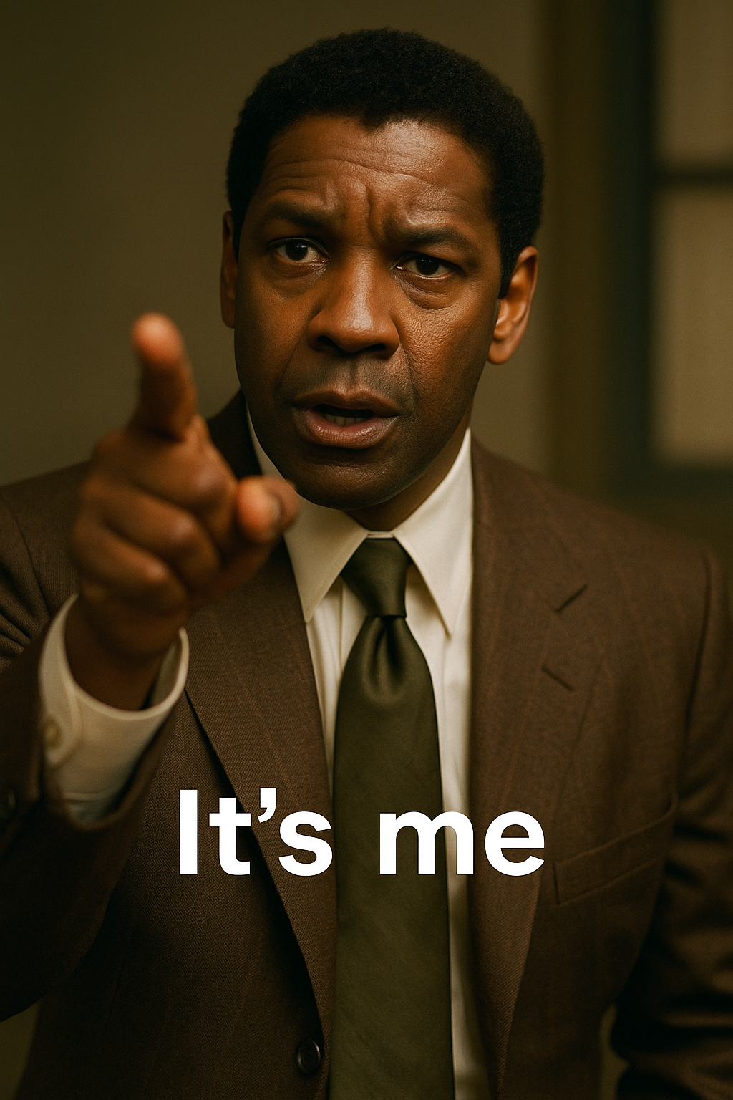
Analysis

Slide 16


Slide 17
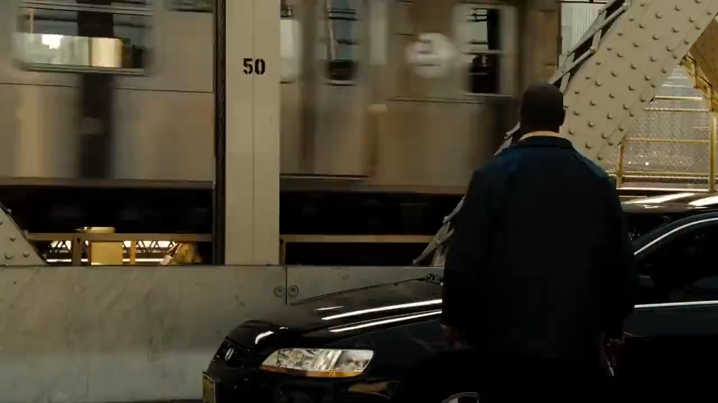

Slide 18
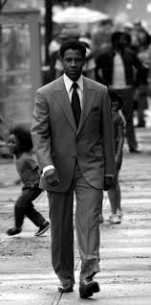
Appearance
Sense of continuity
Layered sense of nostalgia

Slide 19
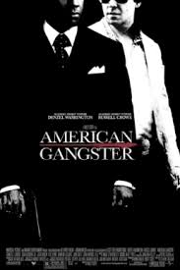
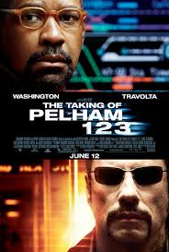
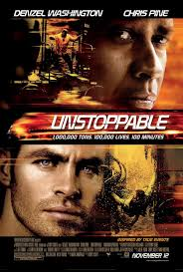
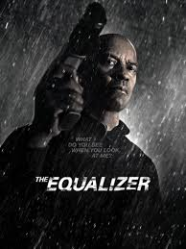
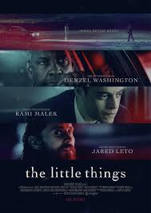
Discussion
Notes:
Keep the rest as hints Gregg Parody ===identifying the signature denzel my man despite is not being repeated the ay he said it became his signature and he is asked a lot of time to say the word and prompt as dyer said star is not just onscreen he is off screen persona audience see him this way

Slide 20
Appearance
Frank Lucas (American Gangster).
Walter Garber (The taking of Pelham 123).
Frank Barnes (Unstoppable).
Joe Deacon (The Little Things).
Robert McCall (Equalizer Trilogy)
Notes:
Frank Lucas (American Gangster): Sophisticated suits, silk accessories, and a confident walk reflect a classic gangster archetype.
Walter Garber (Pelham 123): Wears tired office attire, glasses, and slouches—visually marking him as everyman. This contrasts his inner moral depth with his mundane exterior.
Frank Barnes (Unstoppable): Denim, boots, and a baseball cap define him as working-class. Joe Deacon (The Little Things): Dressed in layered, loose, and worn clothing—his look externalizes unresolved trauma,

Slide 21
Voice
Washington uses his voice as a pastiche of moral authority, restraint, and intensity:
Frank Lucas speaks in a low, deliberate tone that evokes control—"The loudest one in the room is the weakest one in the room."
Garber
Barnes
McCall
Deacon
Notes:
Washington uses his voice as a pastiche of moral authority, restraint, and intensity:
Frank Lucas speaks in a low, deliberate tone that evokes control—"The loudest one in the room is the weakest one in the room."
Garber speaks nervously and hesitantly, portraying guilt and insecurity.
Barnes employs a calm but commanding voice—he sounds like a man used to being obeyed without needing to shout.
McCall’s voice is almost meditative—quiet, even poetic, right before acts of violence. It's both spiritual and terrifying.
Deacon's speech is flat, tired, and unhurried—his voice drips with regret and detachment.

Slide 22
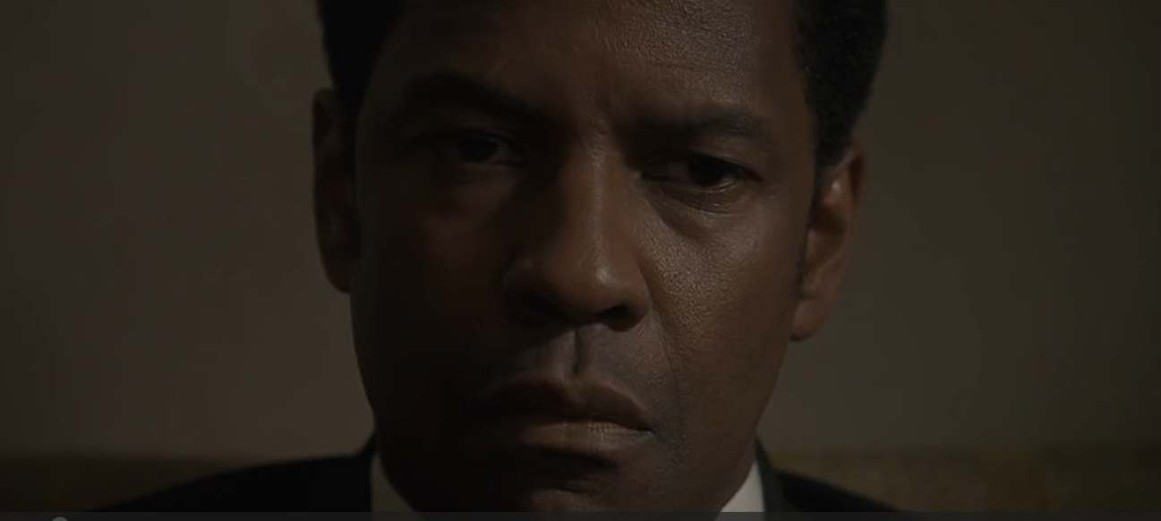
Camera Work
Close-ups
Zoom-ins
Framing and shadow
American Gangster

Slide 23
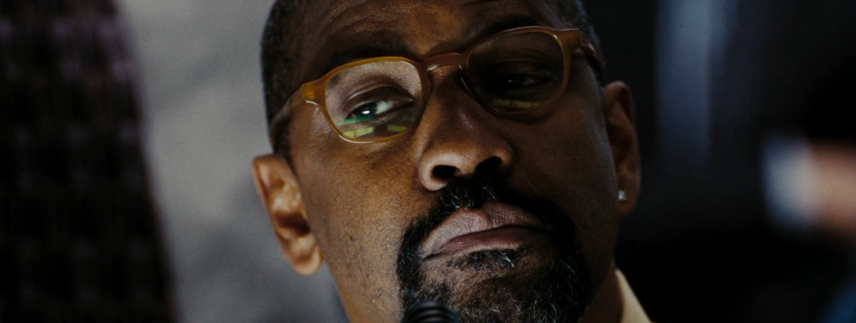
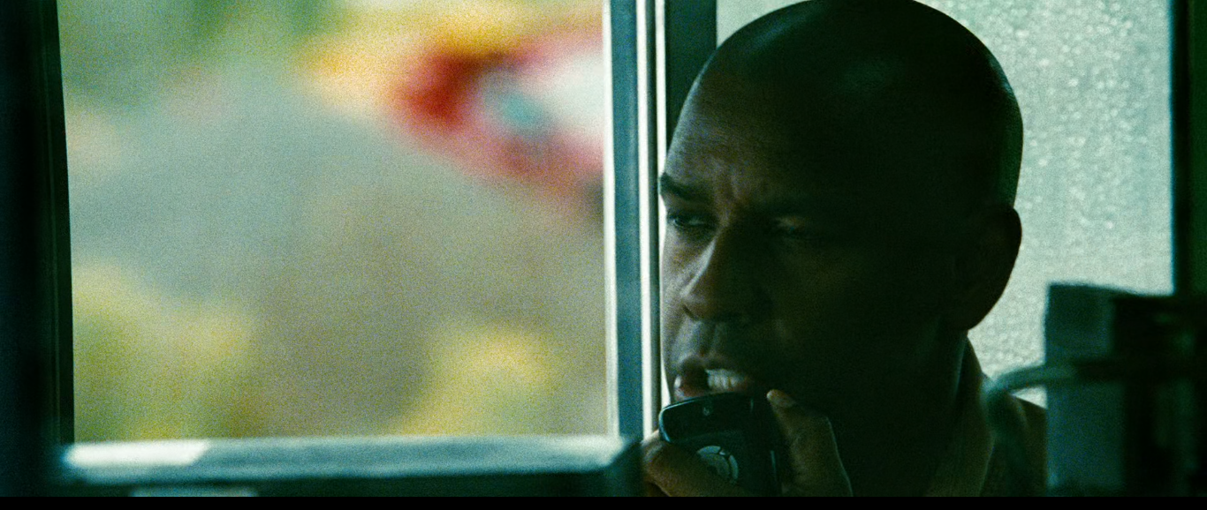
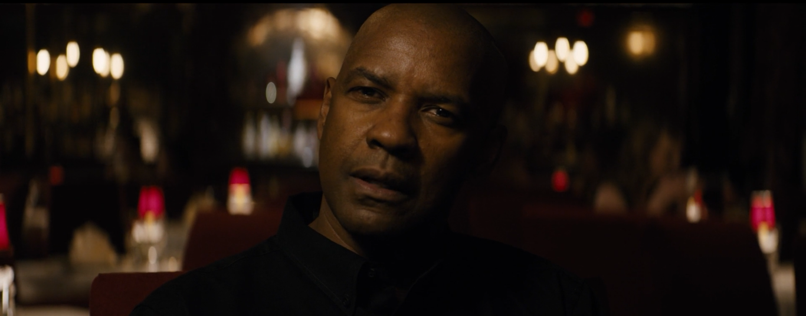
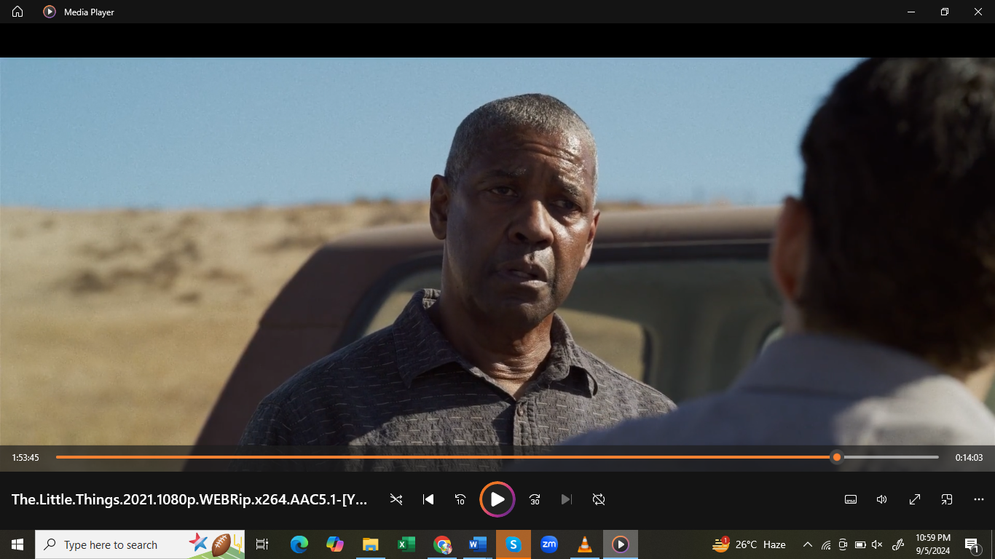
The Taking of Pelham 123
Unstoppable
Equalizer 2
The Little Things

Slide 24
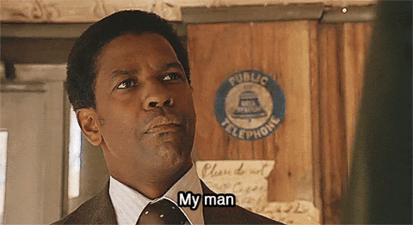
Dialogue
My Man
Notes:
Washington’s characters often repeat moral or philosophical lines:
"You gotta be who you are in this world" (The Equalizer).
"That's the job" (Unstoppable).
“It’s the little things that get you caught” (The Little Things).
These lines function as thematic glue, resurfacing in different contexts to show how Washington reworks familiar ideas.
Through these repeated lines, Washington creates a dialogic pastiche—a network of self-referencing ideas that transcend genre or role.

Slide 25
Creativity
Pastiche is not just imitation
Star as a living intertext
Notes:
Pastiche is not imitation, but accumulation—each performance layers on top of the last, deepening meaning through visual, vocal, and dialogic continuity.
Denzel Washington’s mastery of subtle performance—through voice, silence, appearance, and gaze—allows characters to “speak” to each other across different films.
His screen presence functions as a living intertext—viewers don’t just watch the current role, they remember the others.
This form of pastiche creates complex moral and emotional narratives that enrich contemporary cinema, especially in thrillers and dramas.

Slide 26
Recommendation for future studies
Pastiche in terms of female stars
Directors’ technique
Notes:
(discrimination portray against black as weak and criminals, we can establish parallels, previpus heros persona is built ideology tool)

Slide 27
Significance of the study
Newness in terms of stars can be studied
Repetition in terms of roles, appearances, voice, dialogues, and camera work
Broadens the philosophical debate about pastiche
Notes:
(add constituents star value is more important
Increasing scope of the way audience engage with the film showing a film is not a complete work in itself it is linked with other works studied this I can aspect I can show that they can read about educating student in terms of film stars and meaning created not just about the stars but also pastiche is also there in other things
Mainly concentrating on Denzel Washington, the study shows how, through repetition, his roles, appearances, voice, dialogues, and camera work create a style that contributes to the characterization and the texts’ complexity. This enriches the research on Denzel’s artistry and broadens the philosophical debate about pastiche by applying performance theory, film, and cultural studies. The study offers a new perspective on how meaning is constructed in film through the agency of the actors, further avenues of cross-disciplinary qualitative research, and practical implications for academics, teachers, and students in the contexts of literature, film, and media representation.

Slide 29
Literature Review
Studies on pastiche Sarah Smith (Lip and Love):
Pastiche as a critique of Hollywood tropes and racial stereotypes.
Uses repetition to disrupt narratives and recontextualize imagery.
Demonstrates subversive potential of pastiche in cinema.
Constable:
Pastiche in postmodernism blurs past, present, and future.
Cites the rise of pastiche in Hollywood's tendency to remake or refer to previous films.
Notes:
The organizing principal I conducted literature revie for thr gap and to learn from the other studies I looke at studies conducted on pastiche and denzel Washington studies were very recent and after the year and the gap was evident keeping the time in mind if you allow me if I can skip th eliterature review

Slide 30
Ridley Scott’s Blade Runner:
Exemplifies pastiche through blending genres: sci-fi, noir, neo-noir, action, thriller, and crime.
Reflects postmodern themes and genre hybridity.
Illustrates fragmented realities and temporal boundary collapse.
Douglas Pye & Early Film Actors:
Charlie Chaplin as early actor using pastiche (clown, mime, romantic hero).
Richard Burton and Elizabeth Taylor show versatility in shifting styles and roles.
Notes:
Just the names and hea

Slide 31
James Keller on V for Vendetta:
Pastiche as cultural dialogue, not just imitation.
Film as a political text with multiple layers and meanings.
Winczewski:
Visual culture and pastiche fragment identity in postmodern consumer culture.
Identity becomes schizophrenic due to hybridized media and stylistic montages.
Harrod on Richard Linklater:
Dazed and Confused uses nostalgic pastiche critically.
Challenges Jameson's view of pastiche by emphasizing active critique and historiographic awareness.

Slide 32
Elliott on Alice in Wonderland:
Tim Burton's film as a compendium blending multiple source materials.
Encourages multicultural interpretation and deeper cultural reflection.
Tarantino's Films (Christopher Bell):
Uses pastiche to explore gender, race, and historical memory.
Reconstructs cinematic tradition via stylized, genre-aware storytelling.
Bamus on Tarantino’s Soundtracks:
Pastiche in music scenes (e.g., Pulp Fiction, Reservoir Dogs).
Highlights intertextuality and homage through musical cues.

Slide 33
Burlingame on Musical Pastiche:
Musicians like The Beatles and Mark Ronson use pastiche to innovate and pay homage.
Emphasizes originality within reference-laden structures.
Cunningham & Lewis (RZA & Tarantino):
Use of genre mashups and sampling challenges authorship and cultural memory.
Encourage audience engagement and critique through hybridized artistry.
Miller (referencing Jameson):
Postmodern pastiche fragments unity in film, drawing from various cinematic traditions.

Slide 34
Mircea on Hollywood Culture:
Directors like Tarantino and Lynch use pastiche to challenge narrative coherence.
Pastiche acts as an ironic totality, reflecting and mimicking cultural fragmentation.
O’Brien on Doomsday:
Argues that pastiche destabilizes genre boundaries and encourages participatory meaning-making.

Slide 35
ICON PACK

